Slide 1




NEXT GEN EMPLOYABILITY PROGRAM
Creating a future-ready workforce
Team Members
College Name
Student Name : Keerthana J
Student ID : 814721104029
SRM TRP Engineering College

Slide 2

CAPSTONE PROJECT SHOWCASE
Project Title
Notes Sharing Web Application using Django Framework
Abstract | Problem Statement | Project Overview | Proposed Solution | Technology Used | Modelling & Results | Conclusion

Slide 3
Abstract
The Notes Sharing Web Application is a platform designed to facilitate the sharing and collaboration of notes among users.
Built using the Django framework, this application provides a user-friendly interface for creating, editing, and sharing notes.
Users can register an account, create personalized profiles, and securely upload their notes to the platform.
The application offers features such as real-time collaboration, version history, and the ability to organize notes into categories or subjects.
With a responsive design and intuitive user experience, the Notes Sharing Web Application aims to streamline the process of note-taking and sharing, enhancing productivity and collaboration among users.
Source :

Slide 4
Problem Statement
Notes Sharing Web Application
Source :

Slide 5
Project Overview
Create a web application for sharing notes among users. The application should allow users to create, read, update, and delete their notes. Users should also be able to share their notes with other users and view notes shared with them.
Features:
User Authentication: Users should be able to sign up, log in, and log out. Only authenticated users should be able to access the notes sharing features.
Notes Management:
Users can create a new note with a title and content.
Users can view all notes they have created.
Users can update or delete their notes.
Sharing Notes:
Users can share a note with other users by entering their username or email.
Users can view notes shared with them by other users.
Source :

Slide 6
Proposed Solution
Setup Django Project: First, create a new Django project using the following command:
django-admin startproject notes_sharing_app
Create Django App: Inside the project directory, create a new Django app for managing notes:
cd notes_sharing_app
python manage.py startapp notes
Define Models: In the notes/models.py file, define your models for notes and any other related entities. For example: from django.db import models
from django.contrib.auth.models import User
class Note(models.Model):
title = models.CharField(max_length=255)
content = models.TextField()
created_at = models.DateTimeField(auto_now_add=True)
owner = models.ForeignKey(User, on_delete=models.CASCADE)
Source :

Slide 7
Register Models: Register your models in the notes/admin.py file to make them accessible in the Django admin interface:
from django.contrib import admin
from .models import Note
admin.site.register(Note)
Create Views: Define views in the notes/views.py file to handle requests related to notes, such as creating, editing, and deleting notes.
Create URLs: Configure URL patterns in the notes/urls.py file to map URLs to your views.
Create Templates: Create HTML templates in the notes/templates/ directory to render the UI for your web application.
Implement Authentication: Use Django's built-in authentication system to manage user registration, login, and logout.
Apply Migrations: Run python manage.py makemigrations and python manage.py migrate to apply your model changes to the database.
Run the Development Server: Start the Django development server using python manage.py runserver and test your application in a web browser.
Deploy: Once your application is ready, deploy it to a web server following Django deployment best practices.
Source :

Slide 8
Creating views:
from django.shortcuts import render, redirect
from django.contrib.auth.decorators import login_required
from .models import Note
from .forms import NoteForm
@login_required
def note_list(request):
notes = Note.objects.filter(created_by=request.user)
return render(request, 'notes/note_list.html', {'notes': notes})
@login_required
def create_note(request):
if request.method == 'POST':
form = NoteForm(request.POST)
if form.is_valid():
note = form.save(commit=False)
note.created_by = request.user
note.save()
return redirect('note_list')
else:
form = NoteForm()
return render(request, 'notes/create_note.html', {'form': form})
Source :

Slide 9


Technology Used
Front-end
Back-end
Source :

Slide 10
Modelling & Results
To conclude the development of a notes sharing web application using Django, here's a summary of the key steps and considerations:
1. Setup and Installation: Start by setting up a new Django project and creating a Django app specifically for managing notes.
2. Database Modeling: Design the database models to represent notes and users. Consider relationships between models, such as ForeignKey relationships for associating notes with their authors.
3. Views and Templates: Define views to handle different actions such as listing, creating, updating, and deleting notes. Create corresponding HTML templates to render these views.
4. User Authentication: Implement user authentication to allow users to register, log in, and manage their own notes securely. Django provides built-in authentication features that you can leverage for this purpose.
5. URL Configuration: Map URLs to views using Django's URL patterns. Define meaningful URLs that make it easy for users to navigate through your application.
Source :

Slide 11
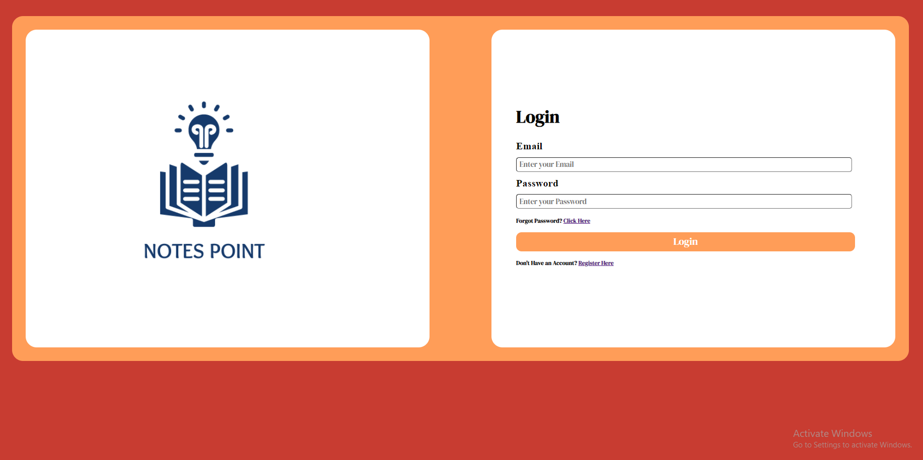
Homepage

Slide 12
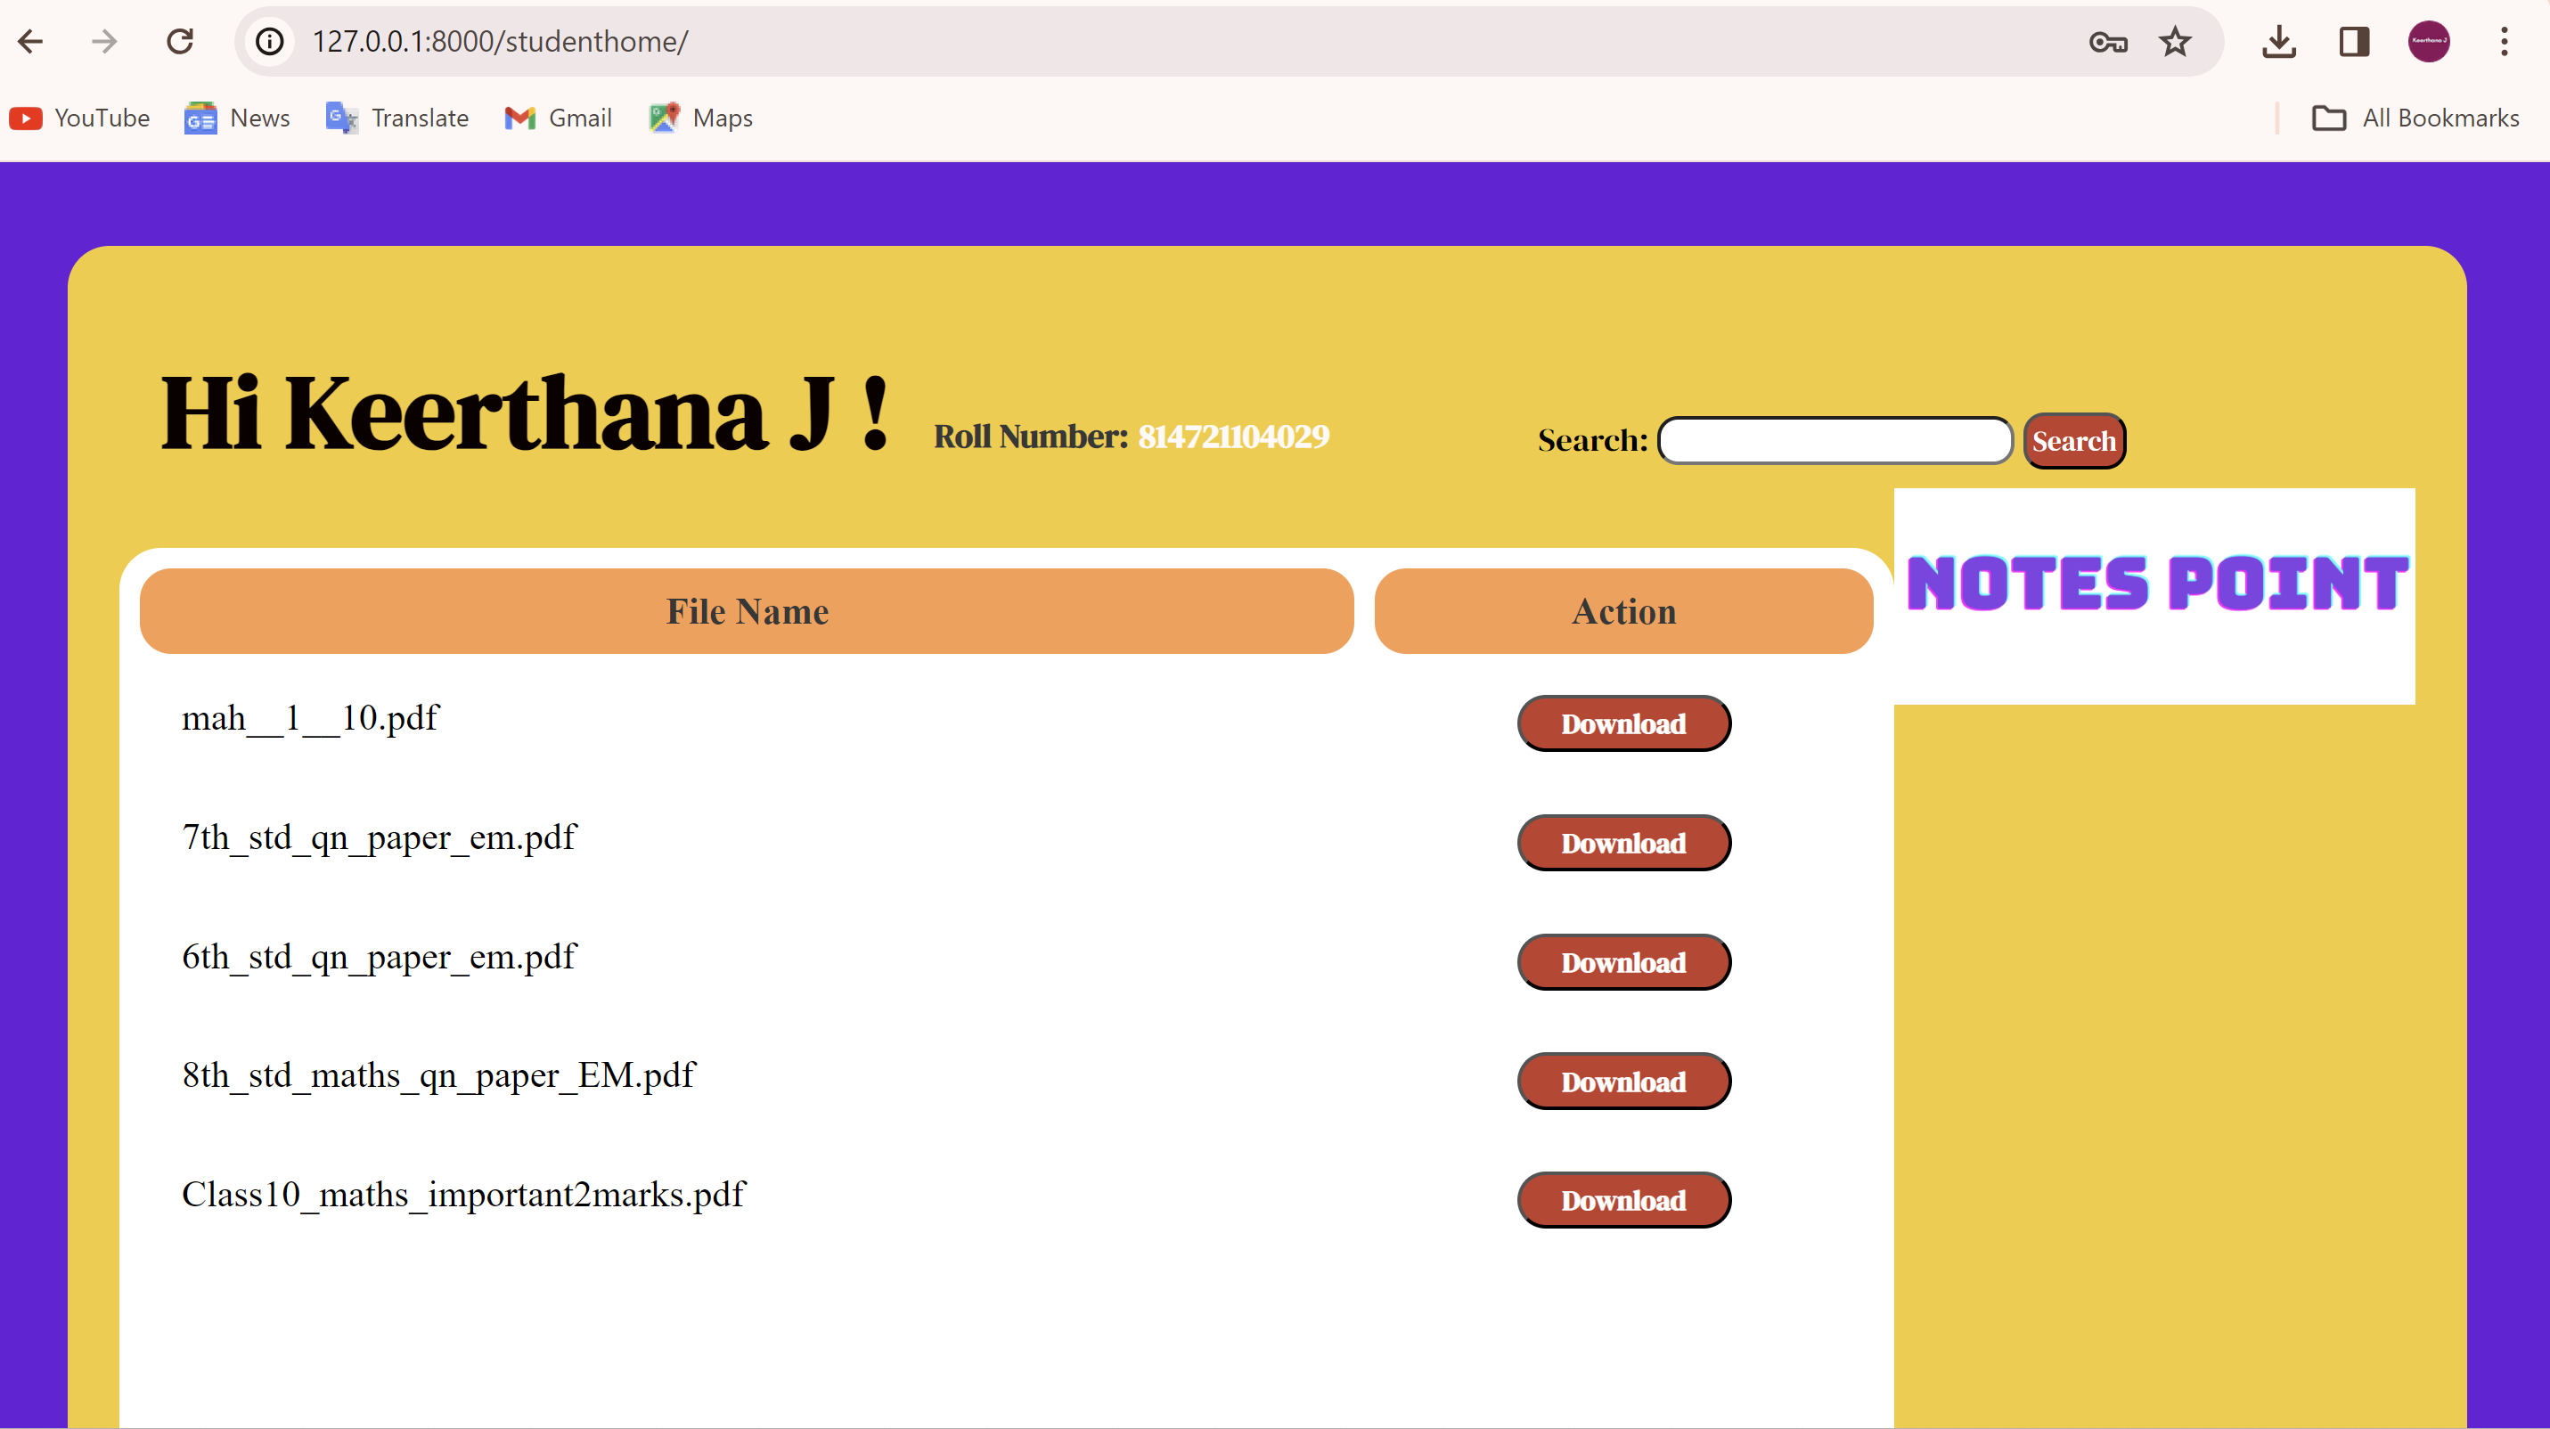
Student Homepage

Slide 13
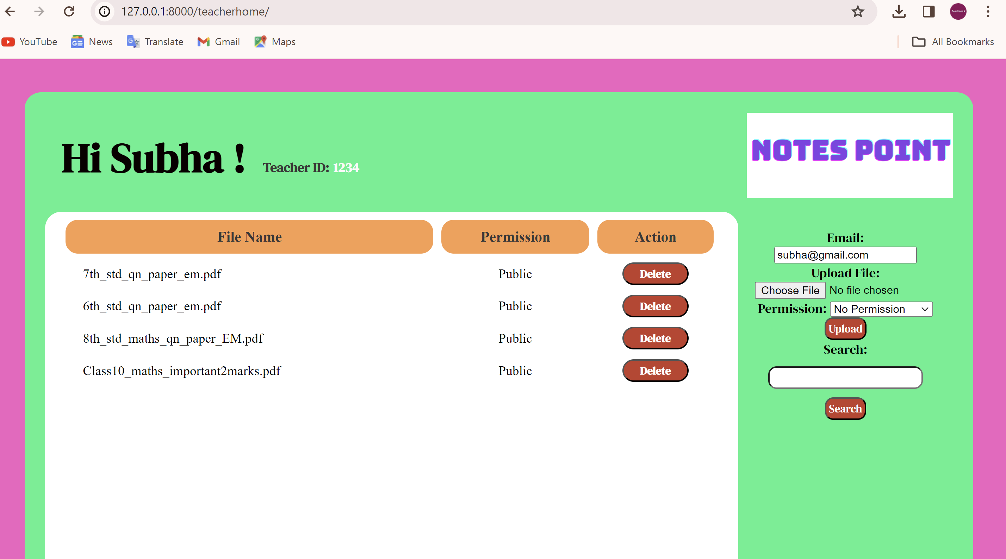
Teachers Home Page

Slide 14
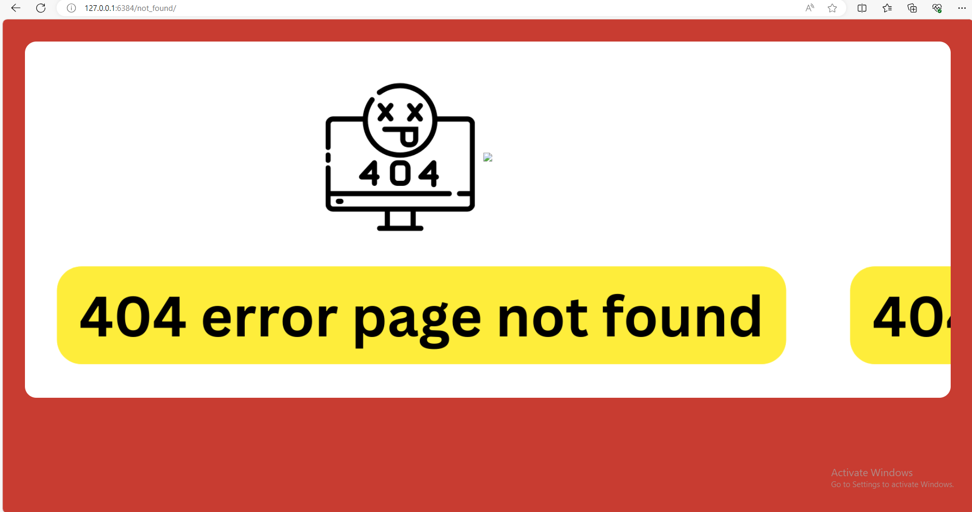
404 Not found

Slide 15
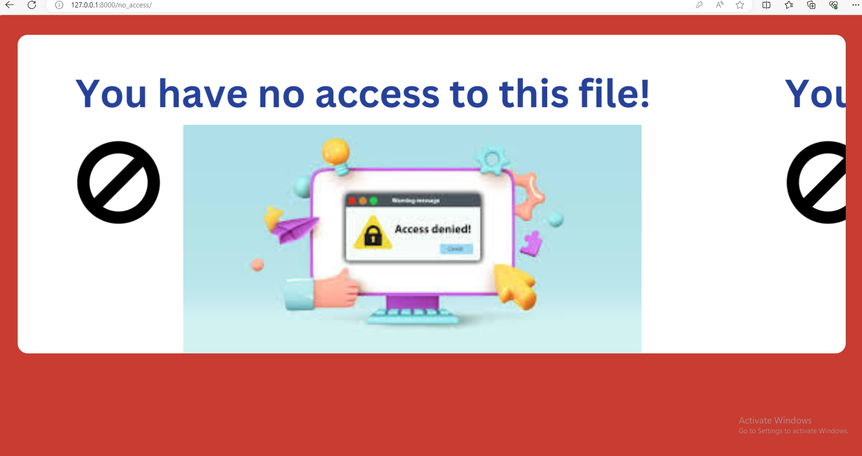
No Access

Slide 16
Future Enhancements:
1. User Profiles:Allow users to create profiles with their details, profile pictures, and a bio. This can add a personal touch to the application and make it more engaging.
2. Social Sharing: Implement social sharing features so users can easily share their notes or favorite notes with others on platforms like Facebook, Twitter, etc.
3. Collaborative Editing:Enable collaborative editing of notes, where multiple users can work on the same note simultaneously, similar to Google Docs.
4. Comments and Discussions: Add a comments section to each note where users can ask questions, provide feedback, or engage in discussions related to the note.
5. Search Functionality: Improve the search functionality to allow users to easily find notes based on keywords, tags, or categories.
6. Offline Access: Implement offline access using service workers so users can access their notes even when they are not connected to the internet.
7. Mobile App: Develop a mobile app version of the notes sharing application to provide a seamless experience for users on mobile devices.
8. Analytics: Add analytics to track user engagement, popular notes, and other relevant metrics to gain insights into how users are interacting with the application.
9. Accessibility: Ensure that the application is accessible to users with disabilities by following best practices and standards for web accessibility.
10. Security Enhancements: Implement additional security measures such as two-factor authentication, data encryption, and regular security audits to protect user data.
These enhancements can help improve the functionality, usability, and user experience of notes sharing web application.

Slide 17
Conclusion
In conclusion, developing a notes sharing web application using the Django framework can be a rewarding experience. Django provides a robust set of tools for building web applications quickly and efficiently, making it ideal for projects like this.
Throughout the development process, we've covered various aspects, including:
1. Setting up Django: We started by installing Django and creating a new project and app. We also configured the database and static files settings.
2. Creating Models: We defined models for users, notes, and tags, utilizing Django's built-in User model for authentication and extending it as needed.
3. Implementing Views: We implemented views to handle user registration, login, logout, note creation, editing, deletion, and sharing.
4. Designing Templates: We designed templates using HTML, CSS, and Jinja2 templating language to create the user interface for our application.
5. Implementing Features: We added features like searching notes, filtering notes by tags, and displaying shared notes.
6. Implementing Authentication: We used Django's authentication system to handle user authentication and authorization, ensuring that users can only access their own notes.
7. Deploying the Application: Finally, we discussed deploying the application to a hosting provider like Heroku or AWS to make it accessible to users.
Overall, building a notes sharing web application with Django involves understanding the framework's key components, such as models, views, templates, and forms, and utilizing them to create a cohesive and functional application. With Django's robust features and documentation, you can create a secure and efficient notes sharing platform that meets your users' needs.
Source :

Slide 18
Thank You!
Notes:
Thank You !!

